Slide 1
Distributed Systems
Centralized Deadlock Detection:
HO Ramamurthy (Two-Phase Algorithm),
HO Ramamurthy (One Phase Algorithm)

Slide 2
Centralized approach –
In the centralized approach, there is only one responsible resource to detect deadlock. The advantage of this approach is that it is simple and easy to implement, while the drawbacks include excessive workload at one node, single-point failure (that is the whole system is dependent on one node if that node fails the whole system crashes) which in turns makes the system less reliable.

Slide 3
The Ho-Ramamoorthy Algorithms
  Two phase (can be for AND or OR model)
    each site has a status table of locked and waited resources
    the control site will periodically ask for this table from each node
    control node will search for cycles and, if found, will request the table again from each node
    Only the information common in both reports will be analyzed for confirmation of a cycle

Slide 4
The Ho-Ramamoorthy Algorithms (cont)
  One phase (can be for AND or OR model)
    each site keeps 2 tables; process status and resource status
    the control site will periodically ask for these tables (both together in a single message) from each node
    the control site will then build and analyze the WFG, looking for cycles and resolving them when found

Slide 5
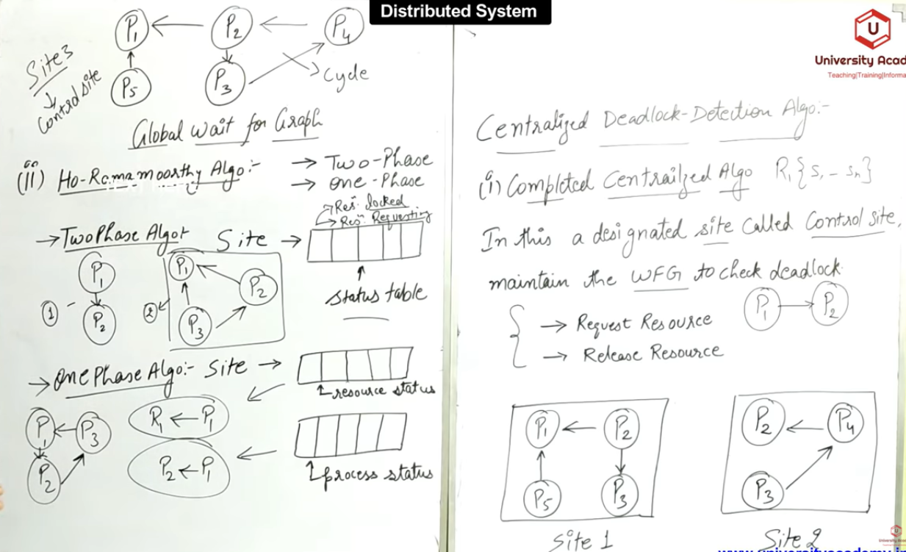

Slide 6
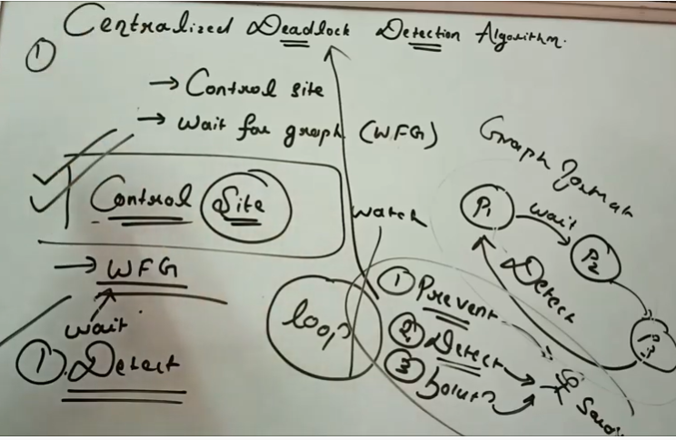
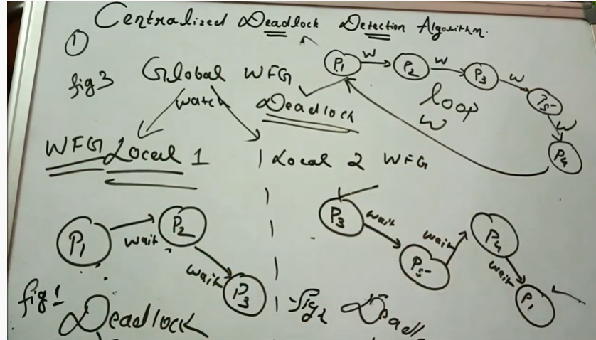
no
no

Slide 7
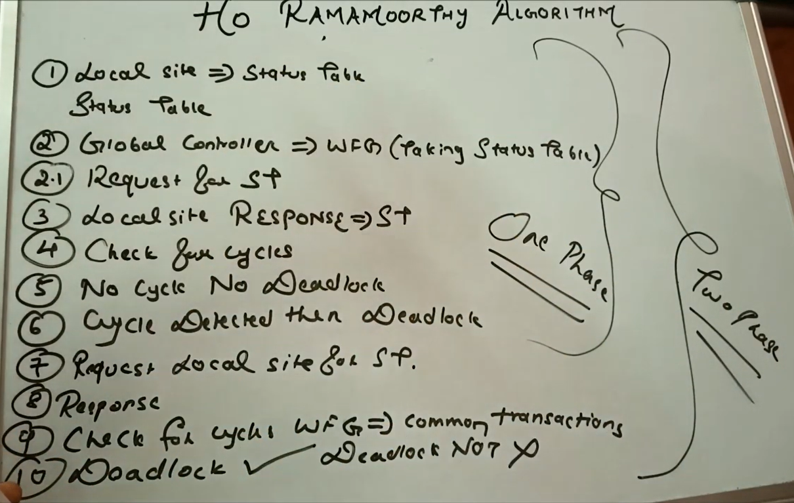

Slide 8
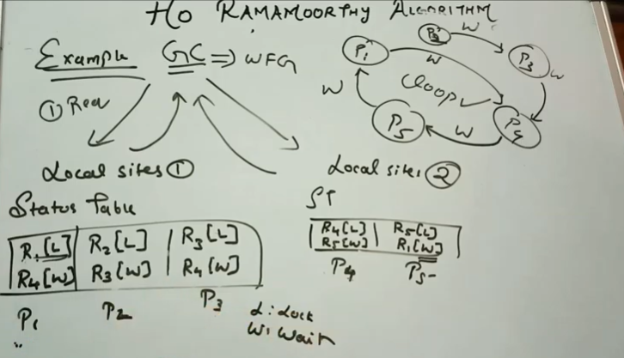
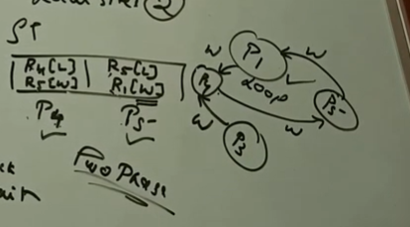
HO –Ramamoorthy: 1-Phase algorithm
HO –Ramamoorthy: 2-Phase algorithm
In 2-phase all is same as 1-phase.
If deadlock is found in 1-phase, the local site will again send its status table but this time it will send the common process found in different local sites

